Slide 1
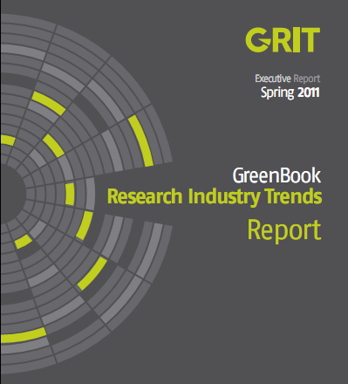
Market Research: An Industry in Transition

Slide 2
MAJOR fINDINGS
Major structural and systemic changes being faced by those in the marketing research industry.
The Top 50 Market Research Firms Perceived to be Innovative.
Despite a backdrop of professional pessimism, anticipated levels of future research spending are actually favorable.
Gaps between Suppliers and Buyers, tenure in the industry, age of respondents and geographic location exist when it comes to emerging technology adoption.
Social media, mobile, MROCs and text analytics are the newer techniques most likely to be used in the foreseeable future.
Utilizing the latest and most advanced technology is certainly important to both clients and suppliers, but the business relationship itself – personal service, responsiveness, and attentiveness – rises to the very top of the list of decision-making criteria.

Slide 3
Drivers of change
Market Research Suppliers
New competitors: Marketing Agencies, BI Tech, DIY, SM
Client demands: ROI, Integration, Implications & Outcomes
Consumers: Engagement, Socialization, Fun, Rewards
Technology: SM, Mobile, Converged Data
Economics: Cheaper, Faster, Better
Human Capital: Changing skill sets

Slide 4
Implications and outcomes
Traditional Business Model for MR
Data silos
Methodological rigor
Objective Reporting
Low touch
Production models
Slow to adapt to technology
Process vs. People
Transition Model
Data Warehouses
Methodologically curious
Narratives & Implications
High touch
Deep partnerships
Embracing technology
People vs. Process
Future Model
Data Oceans
Methodologically agnostic
Narratives, Implications & Outcomes
High touch
Integration with client orgs
Leading technology
People-driven
International expansion
Regional focus
No borders/local focus

Slide 5
Top 50 companies perceived to be innovative
 | Total Mentions | Absolute Rank |  |  | Total Mentions | Absolute Rank
Brainjuicer | 60 | 1st |  | Burke Inc. | 7 | Tied for 16th
TNS Global | 32 | Tied for 2nd |  | MarketTools | 7 | Tied for 16th
Vision Critical | 32 | Tied for 2nd |  | E Rewards | 6 | Tied for 17th
Synovate | 31 | 3rd |  | Emsense | 6 | Tied for 17th
Ipsos | 25 | Tied for 4th |  | Forrester | 6 | Tied for 17th
Nielsen | 25 | Tied for 4th |  | Gallup | 6 | Tied for 17th
Anderson Analytics | 21 | 5th |  | Hall and Partners | 6 | Tied for 17th
Itracks | 18 | 6th |  | One Point | 6 | Tied for 17th
GFK | 17 | 7th |  | Insight Express | 5 | Tied for 18th
Peanut Labs | 16 | 8th |  | Insites Consulting | 5 | Tied for 18th
20/20 | 15 | Tied for 9th |  | Nunwood | 5 | Tied for 18th
Communispace | 15 | Tied for 9th |  | StrategyOne | 5 | Tied for 18th
Millward Brown | 14 | 10th |  | Truth | 5 | Tied for 18th
IModerate | 13 | 11th |  | Allegiance | 4 | Tied for 19th
Maritz | 11 | Tied for 12th |  | Buzzback | 4 | Tied for 19th
OTX | 11 | Tied for 12th |  | Copernicus | 4 | Tied for 19th
QualVu | 11 | Tied for 12th |  | Insights Now | 4 | Tied for 19th
InfoSurv | 10 | Tied for 13th |  | KidsEyez | 4 | Tied for 19th
Revelation Global | 10 | Tied for 13th |  | Lieberman Research | 4 | Tied for 19th
Toluna | 10 | Tied for 13th |  | Market Probe | 4 | Tied for 19th
Affinova | 9 | 14th |  | Sands Research | 4 | Tied for 19th
Gongos Research | 8 | Tied for 15th |  | SPSS | 4 | Tied for 19th
Knowledge Networks | 8 | Tied for 15th |  | USamp | 4 | Tied for 19th
Neurofocus | 8 | Tied for 15th
Research Now | 8 | Tied for 15th
Vovici | 8 | Tied for 15th

Slide 6
Our panel
Kristin Luck, President & Chief Brand Evangelist of Decipher
Kristin Schwitzer, President of Beacon Research & Editor of NewQual Blog
Roxana Strohmenger, Analyst serving Market Insights Professionals

Slide 7
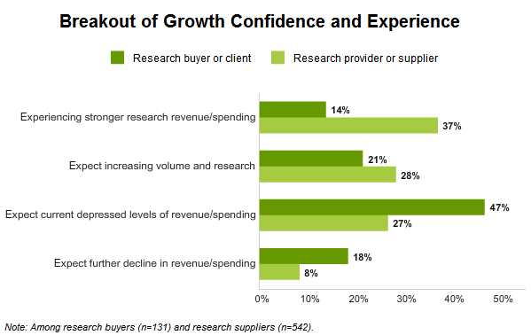
A crisis of confidence despite good news
Despite professional pessimism, anticipated levels of future research spending are favorable.
 | Fall 2010 | Spring 2010 | Gap
Base: | (673) | (875) | + / -
 | % | %
Value Research Same/More (Net) | 55% | 75% | -20%
Value research more today | 18% | 18% | -
Value research about the same | 37% | 57% | -20%
Value research less today | 45% | 25% | +20%
The erosion in self-perceived respect for research – even versus the prior wave – with a 20 ppt jump in the percent who feel that research is less valued than five years ago.

Slide 8
Younger MR Pros embrace new methods
Q.22 What use of these techniques and approaches do you see ahead in your future?
 | Total | Under 6 Years | 6+ Years | Gap | Research Buyers/ Clients | Research Providers/ Suppliers | Gap
Base: | (673) | (73) | (600) | + / - | (131) | (542) | + / -
 | % | % | % |  | % | % | %
Mobile Surveys | 54% | 63% | 53% | +10% | 41% | 57% | -16%
Online Communities | 53% | 63% | 52% | +11% | 58% | 52% | +6%
Social Media Analytics | 50% | 56% | 49% | +7% | 68% | 45% | +23%
Text Analytics | 38% | 40% | 38% | +2% | 47% | 37% | +10%
Webcam-Based Interviews | 36% | 27% | 37% | -10% | 29% | 37% | -8%
Mobile Qualitative | 31% | 41% | 30% | +11% | 23% | 33% | -10%
Mobile Ethnography | 29% | 36% | 28% | +8% | 25% | 30% | -5%
Apps based research | 28% | 37% | 27% | +10% | 32% | 27% | +5%
Eye Tracking | 21% | 29% | 21% | +8% | 25% | 20% | +5%
Crowdsourcing | 19% | 29% | 18% | +11% | 26% | 18% | +8%
Visualization Analytics | 19% | 27% | 19% | +8% | 24% | 18% | +6%
Virtual Environments | 18% | 16% | 18% | -2% | 15% | 18% | -3%
Predictive Markets | 18% | 26% | 17% | +9% | 21% | 18% | +3%
NeuroMarketing | 12% | 14% | 12% | +2% | 14% | 12% | +2%
Serious Games | 9% | 11% | 9% | +2% | 8% | 10% | -2%
Biometric Response | 9% | 7% | 9% | -2% | 11% | 8% | +3%

Slide 9
Predictive Market Results

Slide 10
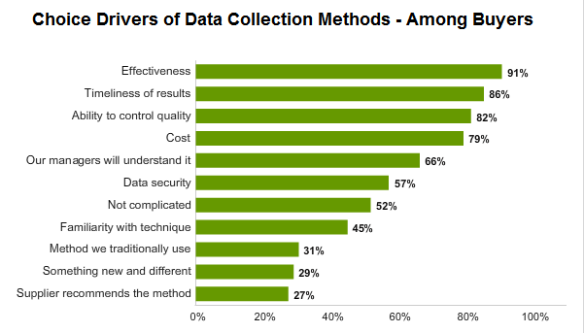
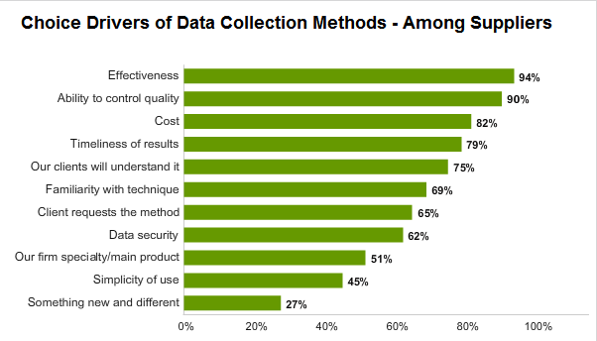
Drivers of methodology choice
When making decisions about data collection methods, respondents stress four key factors: effectiveness, timeliness, quality, and cost
New technology must address one or more of these basic requirements. Being novel per se is insufficient to drive widespread adoption of new research technology.

Slide 11
Personal relationships are key
Having the latest and most advanced technology important to prospective clients, but aspects of the business relationship itself – specifically, personal service and attentiveness dimensions – rise to the very top.
Q.37 How important do you think each of the following qualities is to [clients / you] when [they / you] select a [QUANTITATIVE/QUALITATIVE] research provider? (Top Two Box Basis on Five-Point Scale) | QUANTITATIVE Supplier Factors | QUALITATIVE Supplier Factors | Gap + / -
Listens well and understands client needs | 93% | 93% | -
Good relationship with client/supplier | 92% | 89% | +3%
Familiarity with client needs | 90% | 90% | -
Rapid response to requests | 89% | 88% | +1%
Completes research in an agreed-upon time | 88% | 87% | +1%
Has knowledgeable staff | 87% | 85% | +2%
Previous experience with client/supplier | 84% | 83% | +1%
Good reputation in the industry | 83% | 79% | +4%
Flexibility on changing project parameters | 81% | 85% | -4%
Familiarity with the industry or category | 79% | 76% | +3%

